Slide 1
Secondary Dwelling Units
Orchard Park/Sherwood Forest Ratepayers Association
Community Meeting
January 29, 2014

Slide 2
Secondary Dwelling Units
Today’s Presentation:
Why New Policies?
Our Existing Framework.
Where we are.
What are Secondary Dwelling Units?
Public Consultation
City’s Goals.
Proposed Framework.

Slide 3
Why New Policies?
  Bill 140 → Strong Communities through Affordable Housing Act, 2011
  Changes to the Planning Act
  Affordable Housing = Provincial Interest
  Official Plan policies must contain policies to allow for Secondary Dwelling Units within (Section 16(3)):
  Single Detached Dwellings
  Semi Detached Dwellings
  Townhouses; OR
  Accessory Structures of Singles, Semis and Townhouses
Notes:
Image Source: SFD – LFPress

Slide 4
Why New Policies?
Ministry of Municipal Affairs and Housing (MMAH)
Noted Benefits:
Providing homeowners an opportunity to earn additional income to help meet the cost of home ownership.
Providing more housing options for extended family or elderly parents, or for a live-in caregiver;
Increasing stock of rental units in an area;
Maximizing densities and through efficient use of infrastructure;
Creating jobs in the construction/renovation industry.

Slide 5
Municipal Considerations (from MMAH):
Second units should be permitted in both existing residential communities and in newly developing areas.
While the Act requires municipalities to permit second units, the government recognizes there may be inherent constraints within portions of a municipality or community which would make those areas inappropriate for second units.
Municipalities should assess where second units may be appropriate in the primary dwelling versus the ancillary structure.
Municipalities that currently permit second units will need to review their official plans and zoning by-laws to assess whether they are permitted in the range of housing types listed in the Act.
While the Act introduced a regulation-making ability for the Minister of Municipal Affairs and Housing to prescribe minimum standards for second units, a regulation has not been issued under this authority. As such, municipalities are responsible for determining what standards or zoning provisions should apply to second units in relation to matters such as minimum unit size or parking requirements. Standards should support the creation of second units.

Slide 6
Why New Policies?
Today (With Changes Made Through Strong Communities through Affordable Housing Act, 2011) (Ministry of Municipal Affairs and Housing):
 | Before Changes Made ThroughStrong Communities through Affordable Housing Act, 2011 | Today (With Changes Made Through Strong Communities through Affordable Housing Act, 2011)
Second Units | Municipalities voluntarily establish second unit official plan policies and zoning by-law provisions. | Municipalities are required to establish official plan policies and zoning by-law provisions allowing second units in single, semi and row houses, as well as in accessory structures (e.g. above laneway garages).
 | Planning Act shelters the municipal establishment of official plan permitting second units in single, semi and row houses from appeal to the Ontario Municipal Board; municipalities may permit second unit in accessory structure but these policies for accessory structures are not sheltered from appeal. | Municipal establishment of official plan policies and zoning by-law provisions permitting second units in single, semi, row houses, and in accessory structures, are sheltered from appeal to the Ontario Municipal Board, except during five year review periods. Sheltering of appeals extends to municipally-determined standards for second units.
 | No standards for second units in legislation (municipalities currently establish their own standards); no ability for MMAH Minister to prescribe standards. | Municipalities continue to have ability to identify appropriate areas for second units, and to establish appropriate standards for second units; Minister has regulation-making authority to prescribe standards for second units.

Slide 7
Why New Policies?
Grandfathering of Second Units (from MMAH):
Second units must comply with any applicable laws, which could include the Building Code, the Fire Code and property standards by-laws. The changes do not “grandfather” any existing second units that do not meet applicable laws.

Slide 8
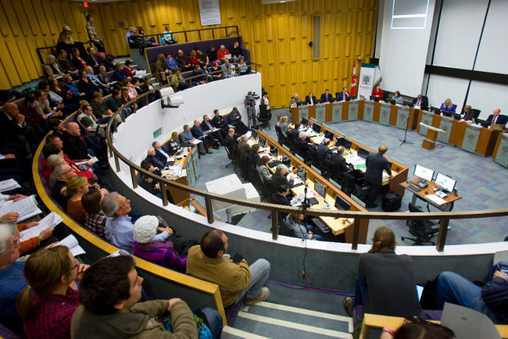
Work Completed So Far
June 2012 – Council direction
public consultation
April 2013 – Draft policies
public consultation
August 2013 – Proposed policies
public Consultation
November 2013 – Referred to staff for
Final public consultation
2014 – Final Recommendation and Draft Amendments
Notes:
https://www.google.ca/url?sa=i&rct=j&q=&esrc=s&source=images&cd=&cad=rja&docid=WKJU3kaI10WcsM&tbnid=0qHbTHjjiSz5IM:&ved=0CAQQjB0&url=http%3A%2F%2Fwww.metropolitiques.eu%2FSoft-densification-in-Canada.html&ei=XKU4UrWvH-ma2gXe8oDgAg&bvm=bv.52164340,d.aWc&psig=AFQjCNENf-8UsLv45ualyk-7L88_DRtAAw&ust=1379530449832522

Slide 9
What are Secondary Dwelling Units?
City of London Existing Terminology (ZBL) for 2 unit dwellings:
Converted dwellings: existing dwellings (pre-93) that have been expanded (up to 10%) to add another unit.
Duplex dwellings: two unit buildings split horizontally.
Semi-detached dwelling: two unit building split vertically
Accessory dwellings: dwellings accessory to non-residential use
Notes:
Image source www.sechelt.ca

Slide 10
What are Secondary Dwelling Units?
What is a different about Secondary Dwelling Units?
Clearly secondary, accessory, and/or ancillary to the primary dwelling.
Opportunity to provide for affordable home ownership.
Opportunities to provide accommodation for a dependant individual.
Opportunities to provide affordable rental accommodations.
Notes:
Image source www.sechelt.ca

Slide 11
City’s Goals
Goals:
Meeting affordable housing needs;
Providing safer accommodation for Londoners;
Intensifying built-up areas;
Providing Londoners with opportunities to “age in place”; and,
Enabling supplemental income for home ownership viability.
Minimize Potential Impacts to:
Parking
Neighbourhood Appearance
Property Maintenance
Ensuring Safety
Providing Services and Infrastructure
Tying to Other Projects:
London Community Housing Strategy
London’s Strengthening Neighbourhood Strategy
Greater Near Campus Neighbourhood Strategy
Age Friendly Plan

Slide 12
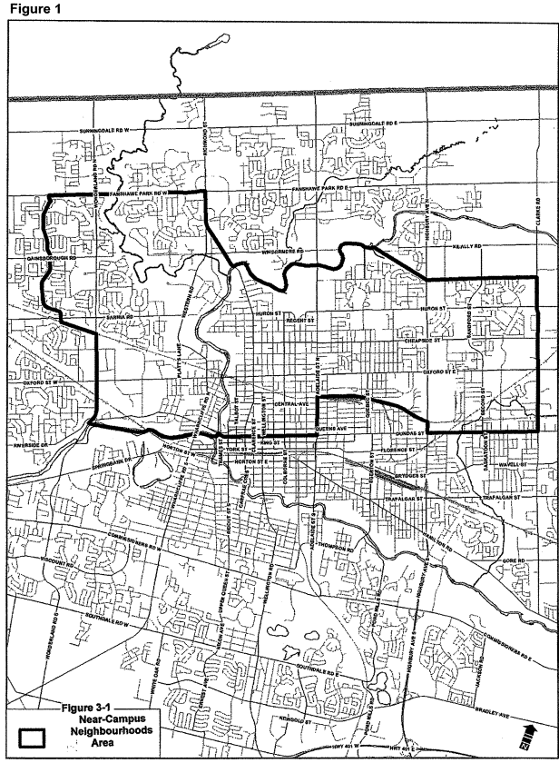
Great Near Campus Neighbourhood Strategy
Multi-faceted strategy
Plan built on Partnership
Adopted Summer 2013
Plan identifies opportunities for appropriate intensification.
Areas pre-zoned for 2 unit dwellings and multi-unit dwellings.
Proposal includes Restriction from Near-Campus Neighbourhood Area

Slide 13
Public Consultation Concerns
Comments from UWO:
The University would be in favour of allowing secondary units, in the near-campus neighbourhood area, as long as the maximum number of bedrooms is three and there is a requirement for the owner to live on-site where the secondary dwelling is located. If townhouses are permitted to have secondary dwelling units, we strongly believe this should only be allowed in instances where the owner lives on the site.

Slide 14
Proposed Framework
Proposed Framework:
Official Plan Policies
Zoning By-law Regulations
Licensing Requirements

Slide 15
Proposed Official Plan Amendments
Proposed Official Plan Policies
Consistent with the changes to the Planning Act.
Secondary dwelling units may be permitted as of right (no ZBA required), provided they meet the policies and regulations.
Secondary dwelling units are permitted in zones, in association with:
  Single detached dwellings;
  Semi detached dwellings;
  Street Townhouses dwellings;
Permitted where the primary unit is owner occupied;
1 secondary dwelling per primary dwelling;
Shall not be permitted in the Great Near Campus Neighbourhood;
1 bedroom maximum; (cap at 5 bedrooms total);
Shall be required to be licensed.
Gross floor area shall be max. 40% of building.

Slide 16
Proposed Official Plan Amendments
Proposed Official Plan Policies Continued...
A secondary dwelling shall comply with all regulations of the associated zone;
Exterior alterations are not permitted
  Exception, entrances in the rear and side yard may be permitted
Maximum of 1 additional parking space.
Secondary dwelling units may be permitted within an accessory structure:
  is located on the same lot as the primary dwelling unit;
  meets the requirements of the zone;
  where the primary dwelling unit does not contain a secondary unit;
  is located in the rear yard;
Secondary dwelling unit shall not be
located in the basement in a floodplain.
Notes:
Image source: www.cmhc-schl.gc.ca

Slide 17
Proposed Zoning By-law Amendment
Proposed Zoning By-law regulations:
New definition for Secondary Dwelling Units
Permitted as of right on any property that permits:
  Single Detached Dwellings;
  Semi-detached Dwellings;
  Street Townhouse Dwellings;
One (1) Secondary Dwelling unit per lot and must be on the same lot as the primary dwelling (includes accessory structures)
Secondary Dwelling units are not permitted in the Greater Near Campus Neighbourhood Area
Not permitted below sanitary systems or in basements within floodplain areas
No greater than 40% of the gross floor area
1 Parking Space required

Slide 18
Proposed Zoning By-law Amendment
Proposed Zoning By-law regulations, Continued...:
Secondary dwelling units are 1 bedroom.
Total number of bedrooms capped at 5.
Exterior alterations shall not be permitted to the front or exterior side yard.
Exterior alterations to provide for entrance to the secondary dwelling unit within interior side yard and rear yard elevations of the primary dwelling may be permitted provided that the interior side yard elevation does not contain more than one entrance.
Exterior alterations to accessory structures that permit secondary dwelling units may be permitted.
Secondary dwelling units must meet all Ontario Building Code and Ontario Fire Code regulations.

Slide 19
Thank You!
Questions?
Eric Lalande
Planner II, Policy Planning and Programs
elalande@london.ca
519-661-2500 x 7602

