Slide 1
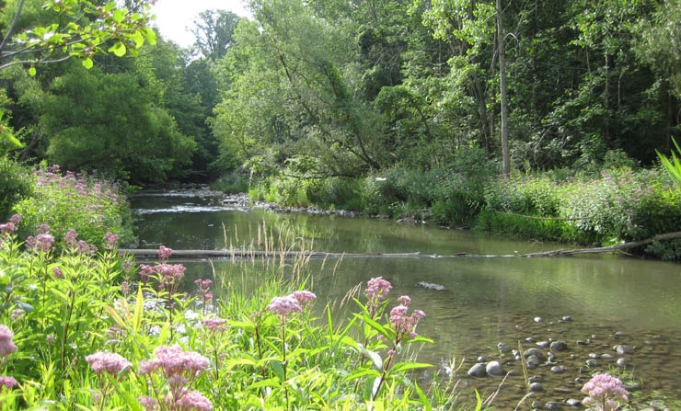
Medway Valley Heritage Forest Environmentally Significant Area
Phase One - Conservation Master Plan
Community Information Meeting
July 25, 2013 7:45 – 8:45 pm
Medway Community Center

Slide 2
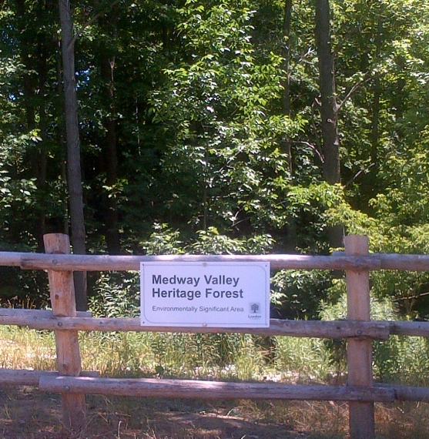
What makes the Medway VHF an ESA?
The ESA has natural features & ecological functions that contribute to ecological integrity & biodiversity as defined by:
Unusual landforms & rare vegetation community types
High-quality vegetation representative of pre-settlement period
Large size provides extensive habitat
Significant watercourse contributes to ecosystem health beyond ESA boundaries
High level of biodiversity
Important wildlife habitat & linkage function
Significant habitat for rare, threatened, endangered species
Notes:
Unique feature of the City’s Natural Heritage and Open Space System
Publicly owned ESAs are a special classification within the park hierarchy

Slide 3
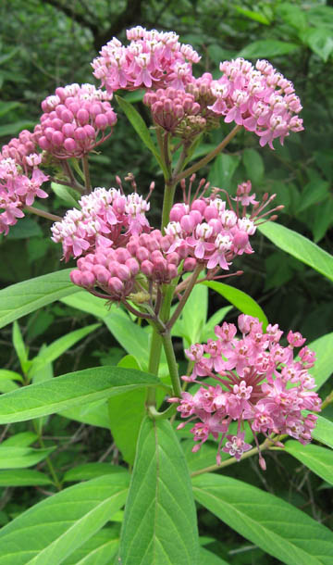
Official Plan Policies for ESAs
ESAs contain natural features and perform ecological functions that warrant their retention in a natural state (15.4.1)
Where necessary, public access to identified ESAs within public ownership will be controlled so that access is not detrimental to the significant features of the property (15.4.1.4)

Slide 4
How do we protect ESAs and permit use?
CONSERVATION MASTER PLAN PROCESS
PHASE 1 (2013): Life Science Inventory and Evaluation
Boundary Delineation
Application of Management Zones*
Identifying Management Issues
PHASE 2 (2014): Community Engagement and Participation
Goals, Objectives, Recommendations
Ecological Protection, Enhancement and Restoration
Trail Planning and Design Process*
Priorities for Implementation
Final Conservation Master Plan
* From the June 2012 Council approved Planning and Design Standards for Trails in ESAs
Notes:
PLANS ARE APPROVED BY COUNCIL THROUGH PUBLIC PARTICIPATION MEETING

Slide 5
Conservation Master Plan - Next Steps
Phase 1 Summary Meeting - January 2014
Phase 2 Start-up Meeting
- February 2014
Phase 2 Local Advisory Committee (LAC) Meeting - March 2014
Phase 2 Process Completed - Fall 2014

